Slide 1

Water quality with Machine Learning
Ashley Dixon

Slide 2


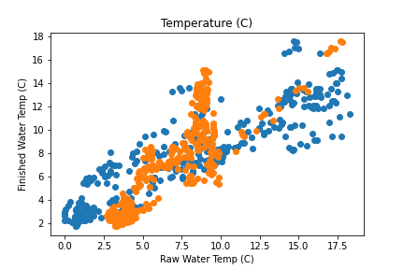
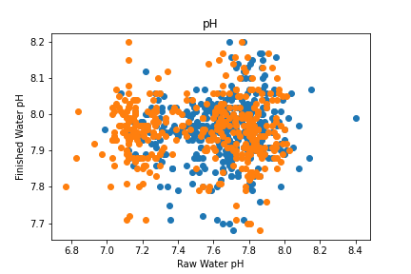
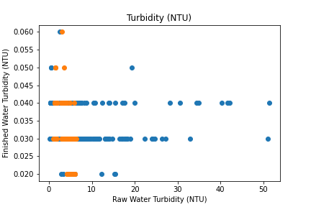
Initial plots

Slide 3
Predicted models
Horsetooth with Finished Water
Poudre with Finished Water

Slide 4
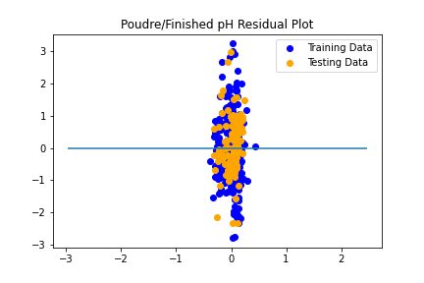
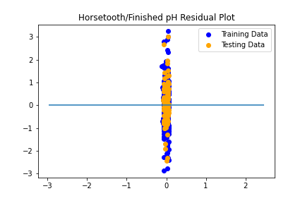
pH

Slide 5
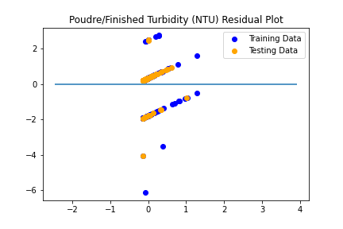
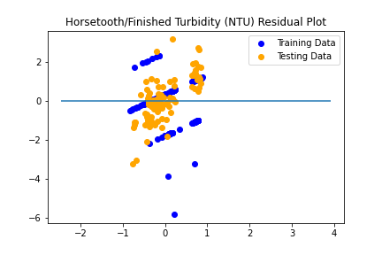
Turbidity

Slide 6
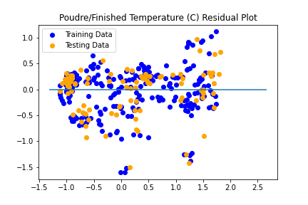
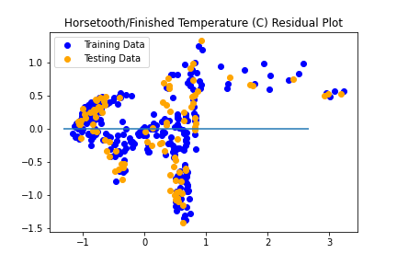
Temperature

Slide 7
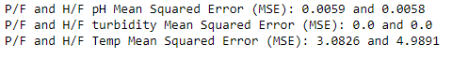
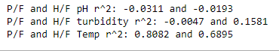
Mean square error and r^2

Slide 8
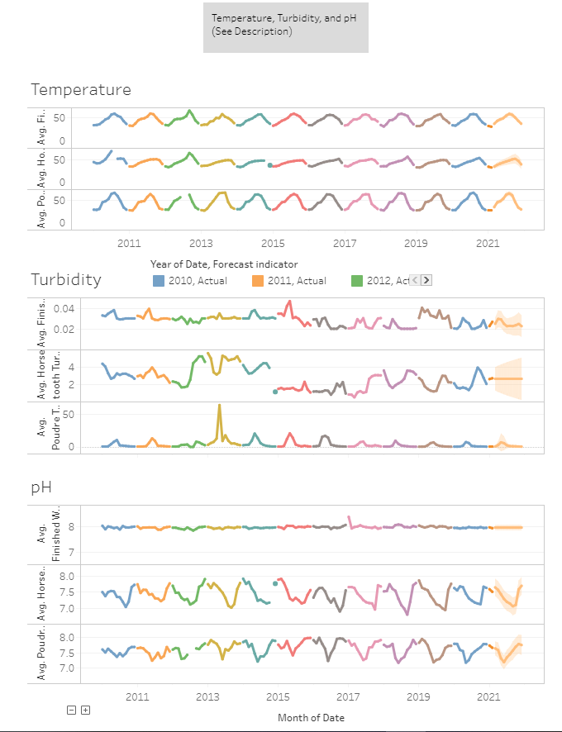
tableau

Slide 9

Conclusion
Turbidity isn’t the only factor in having good water, the temperature of the water plays a big role in it too!
Thank you everyone for a great 6 months!

